Slide 1


CSE 593
Dr. Yinong Chen

Slide 2
The Engineering Design Process
1
Define
Problem
Evaluate
2
Generate
Solutions
Evaluate
3
Decide the Course of Action
Evaluate
4
Implement Solution
5
Final
Evaluation
Dr. Yinong Chen

Slide 3
From Project Management to Design Process
Project management is a function with inputs and output.
The inputs of the function are a limited number of activities and entities related to any part of the project.
  An activity is a named process, function, or task that occurs over limited time. Examples of activities include requirements analysis, design, hiring staff, project status meetings, code reviews, testing, risk identification and even parties
  An entity is something that has a distinct, a separate existence, such a document, though it does not need to be a material existence. Examples of entities include business need, requirements, system architecture, stakeholders, documents, project manager, code, use cases, customer etc
The output of the function is a project, which consists of all the deliverables, services, and products.
The Design Process is to organize the activities and entities.
http://nodis3.gsfc.nasa.gov/npg_img/N_PR_9501_002D_/N_PR_9501_002D__Chp2.pdf
Dr. Yinong Chen

Slide 4
From Project Management to Design Process
Project Management Function
Activity
Activity
Activity
Activity
. . .
Entity
Entity
Deliverables
Entity
Deliverables
Entity
. . .
Design
Process
Deliverables
Products
Products
Products
Services
Services
Services
Dr. Yinong Chen

Slide 5
Design Process
Activities
Entities
Define Problem
Define Problem
Requirement
Initial Research
Literature review, Generate Solution Ideas
Specification
Decide Course
of Action based on Modeling, Analysis, and Simulation
Proposal
Different Types of Implementations
Approval
Simulation
Implementation
Plan
Prototype
Product
Final
Evaluation
Dr. Yinong Chen

Slide 6
Problem Definition:
Requirement & Specification Engineering
User needs
Domain information
Existing system information
Regulations Standards
etc.
Requirement
validation
Agreed-upon
requirements
Modeling
Modeling
Requirement
elicitation
Requirement
document
Specification
Specification
verification
Requirement
analysis and
negotiations
Requirement
documentation
Final
specification
Dr. Yinong Chen

Slide 7
Modeling
Modeling
Engineering Models
Conceptual
Concepts
Concepts
Concepts
Concepts
Mathematical
Concepts
Concept
Physical
Dr. Yinong Chen

Slide 8
Engineering Models
Conceptual Models: Based on description of concepts and relationships among model components
  The five-component model of computer systems
  Flowchart of your design or program
Mathematical Models: Based on logical and quantitative relationships among model components
  Deterministic Models: predictable behavior, always give same answer each time we run the model, for a fixed set of design parameters.
  Stochastic Models: element of chance built into model different unpredictable answer each time we run the model even when design parameters are fixed only average behavior over several runs predictable
Physical Models: Smaller versions of the full-size systems, e.g., a model car, airplane, etc.
Dr. Yinong Chen

Slide 9
Model Elements
Problem Definition
  Boundaries: Pre-conditions or assumptions that are assumed to be true, e.g., the system will be operated in the temperature between 32 and 125 degree.
  Variables: The dimensions that impact the system behaviors.
  Range of values for each variable.
  Relationships or formulas/functions that link the variables together.
  Solution: Using the variables and relationship to specify the problem.
Dr. Yinong Chen

Slide 10
Generating Solutions: Brainstorming
Brainstorming
  Purpose:
    To generate a high volume of ideas in a non-analytical manner
    To permit the ideas of one individual to stimulate the ideas of the other individuals in a team.
Dr. Yinong Chen
Notes:
How to Use
Display and quickly review the items to be covered in today’s class.
Comments
You may want to explain to students that every week we will display the goals and the agenda for the class.
.

Slide 11
Rules of Brainstorming
Objective: To generate as many solution ideas as possible, regardless of feasibility
All ideas are recorded without commentary or judgement
Phrases that are not to be said during brainstorming:
  That won’t work
  That’s too radical
  It’s not our job
not
  We don’t have enough time
  That’s too much hassle
  That’s too expensive
  That’s a stupid idea
  We can’t possibly do that
  You are an idiot
Dr. Yinong Chen

Slide 12
Generating Solutions: Osborn’s Checklist
Objective: To build upon ideas generated from brainstorming, yielding new ideas
The Checklist:
  Adapt?…
    What are other uses for this product/idea/plan?
  Modify?…
    Can we change the shape, material, color, smell?
  Magnify?…
    How can we make this item longer, bigger, faster?
  Minify?…
    How can we make this item smaller, lighter, shorter?
  Substitute?…
    Use different ingredients, material, people?
  Rearrange?
    Other layouts? Parts? Turn upside down, backwards?
  Combine?
    Parts? Units? Ideas? People?
Dr. Yinong Chen

Slide 13
Deciding the Course of Action
In the engineering process, decisions must be made using measurable (quantitative) criteria;
Design the criteria based on careful studies of the requirements and specification;
A common tool used is:
Kepner-Tregoe (K.T.) Decision Analysis; also, called KTDA
Dr. Yinong Chen
Notes:
How to Use
Display and quickly review the items to be covered in today’s class.
Comments
You may want to explain to students that every week we will display the goals and the agenda for the class.
.

Slide 14
KT Decision Analysis
Create a short list of 3-5 design ideas/solutions
Clearly define the design objectives and measurable criteria;
Categorized them into:
  MUSTS: Those objectives/criteria that are required to be met contractually or that must be met for the design to properly function
  WANTS: Those objectives/criteria that would be good for the design to have, but that are not essential contractually or functionally
Dr. Yinong Chen

Slide 15
Decision Analysis
Alternative:
Robot A
Robot B
Robot C
Musts
1. < 20 lb
GO
GO
NO GO
2. < $400
GO
GO
GO
x
Wants
Weight
Rating
Score
Rating
Score
Rating
Score
1. cost
4
7
28
3
12
2. speed
7
4
28
7
49
Total A = 56
Total B = 61
Total C =
Solution B looks like the solution of choice
Dr. Yinong Chen
Notes:
Context
Awareness of the process of completing a KT DA Table
How to Use
This is a build slide. Only the blank table appears at first. With each mouse click, more and more of the table is displayed. As the items are displayed explain what is going on.
Discussion
We are going to review this process by stepping through the process with this build slide. The alternatives are RC (remote control) racing robots. We have a weight and cost constraint (must) and a cost and speed desire. There are numerous things to point out as this table is built.
1. Things can be both a must and a want (see cost)
2. Must have boundaries that cannot be crossed
3. Where do weights come from? Discussion with customer
4. Where does the rating number come from? Experience in the field, models that predict values of wants (predict speed), discussion with customer about what would be considered really good (exceeding expectations)
5. Do you have to accept the results of the table? No table is a tool to help you make your decision; there may be other issues that are not reflected well in the table that might make you choose the other solution. That is one reason why the adverse consequences table is important.
Begin: N/A
End: N/A

Slide 16
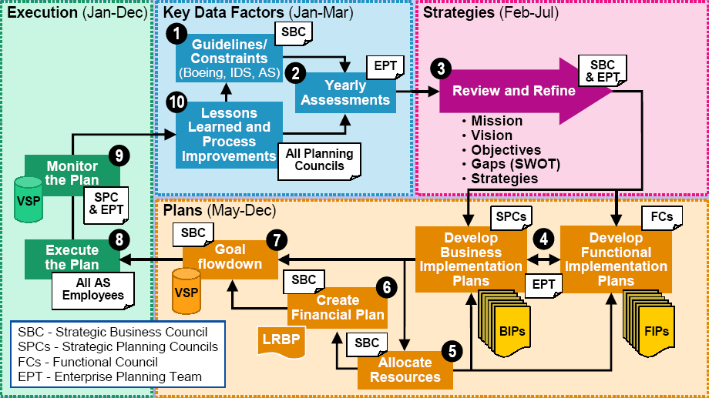
National Institute of Standards and Technology
10-Step Enterprise Planning Process http://www.nist.gov/director/vcat/planning_0606.pdf
Dr. Yinong Chen

